Slide 1

Password Strength Checker — Client-side Guide
Practical, designer-friendly guidance for building a real‑time password strength checker using HTML, CSS, and JavaScript. Target audience: web developers and UX designers who want clear, accessible feedback for users while they type.

Slide 2
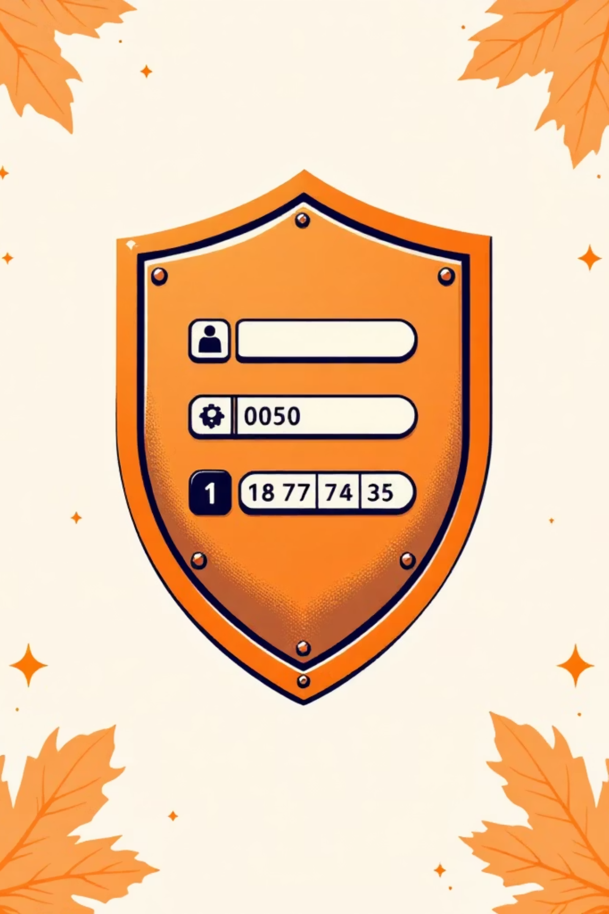
Why this matters
Passwords are the first line of defense. A visible strength meter reduces weak choices, improves user behavior, and prevents common attacks like guessing and credential stuffing. Client-side checks keep latency low and never send the raw password to a server.

Slide 3

Core objectives
Real-time feedback
Clear strength indicator
Evaluate as the user types; immediate visual and textual guidance.
Bar + percentage + label (Weak / Medium / Strong).
Actionable suggestions
Show / hide toggle
Show specific changes (add length, uppercase, symbol) the user can take.
Let users verify input without compromising privacy by default.

Slide 4
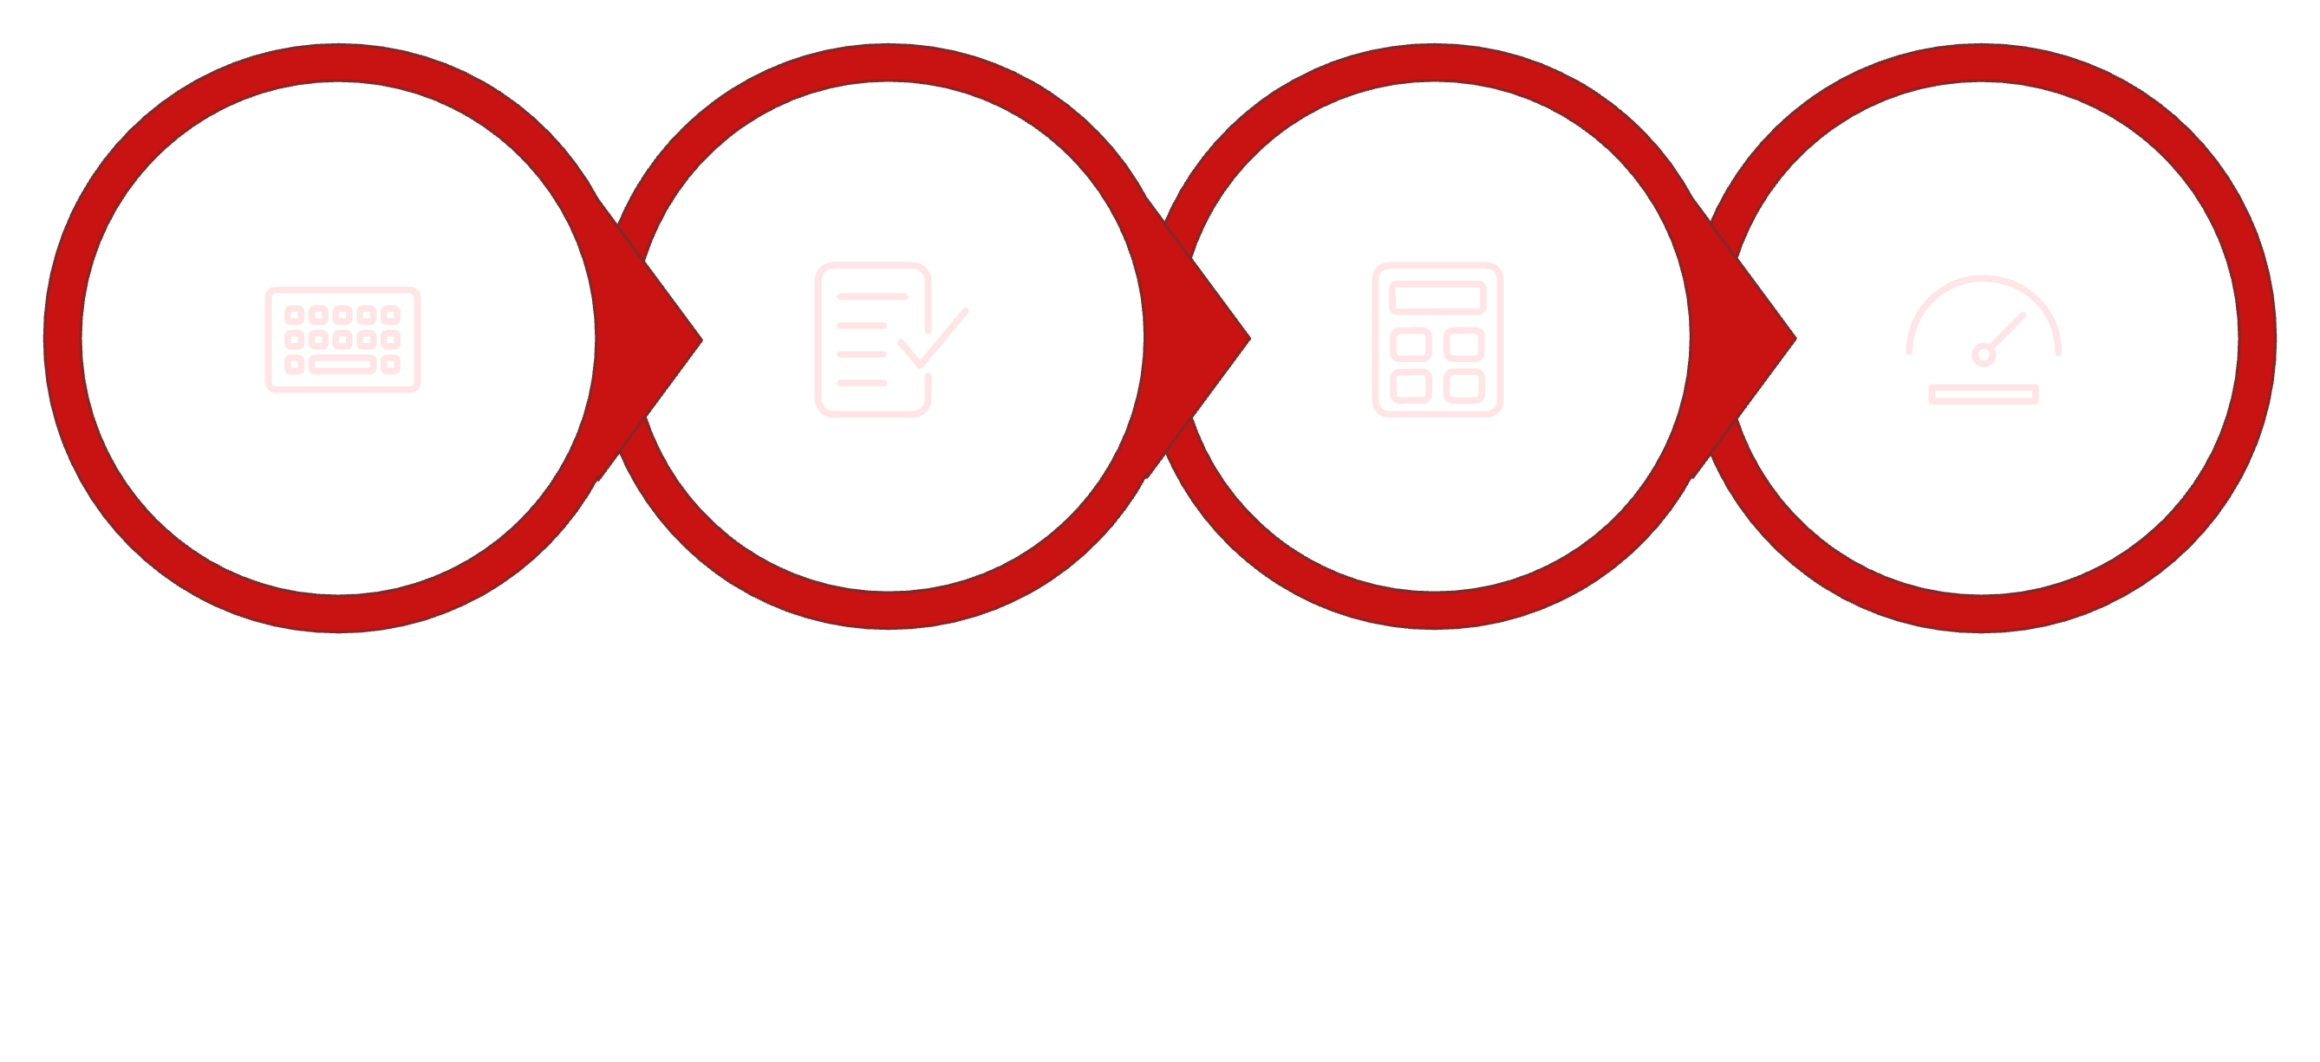
High-level flow
Input Event
Run Validation
Calculate Score
Update UI
This small pipeline runs on each input event. Keep it fast and debounced minimally so feedback feels instant without jank.

Slide 5
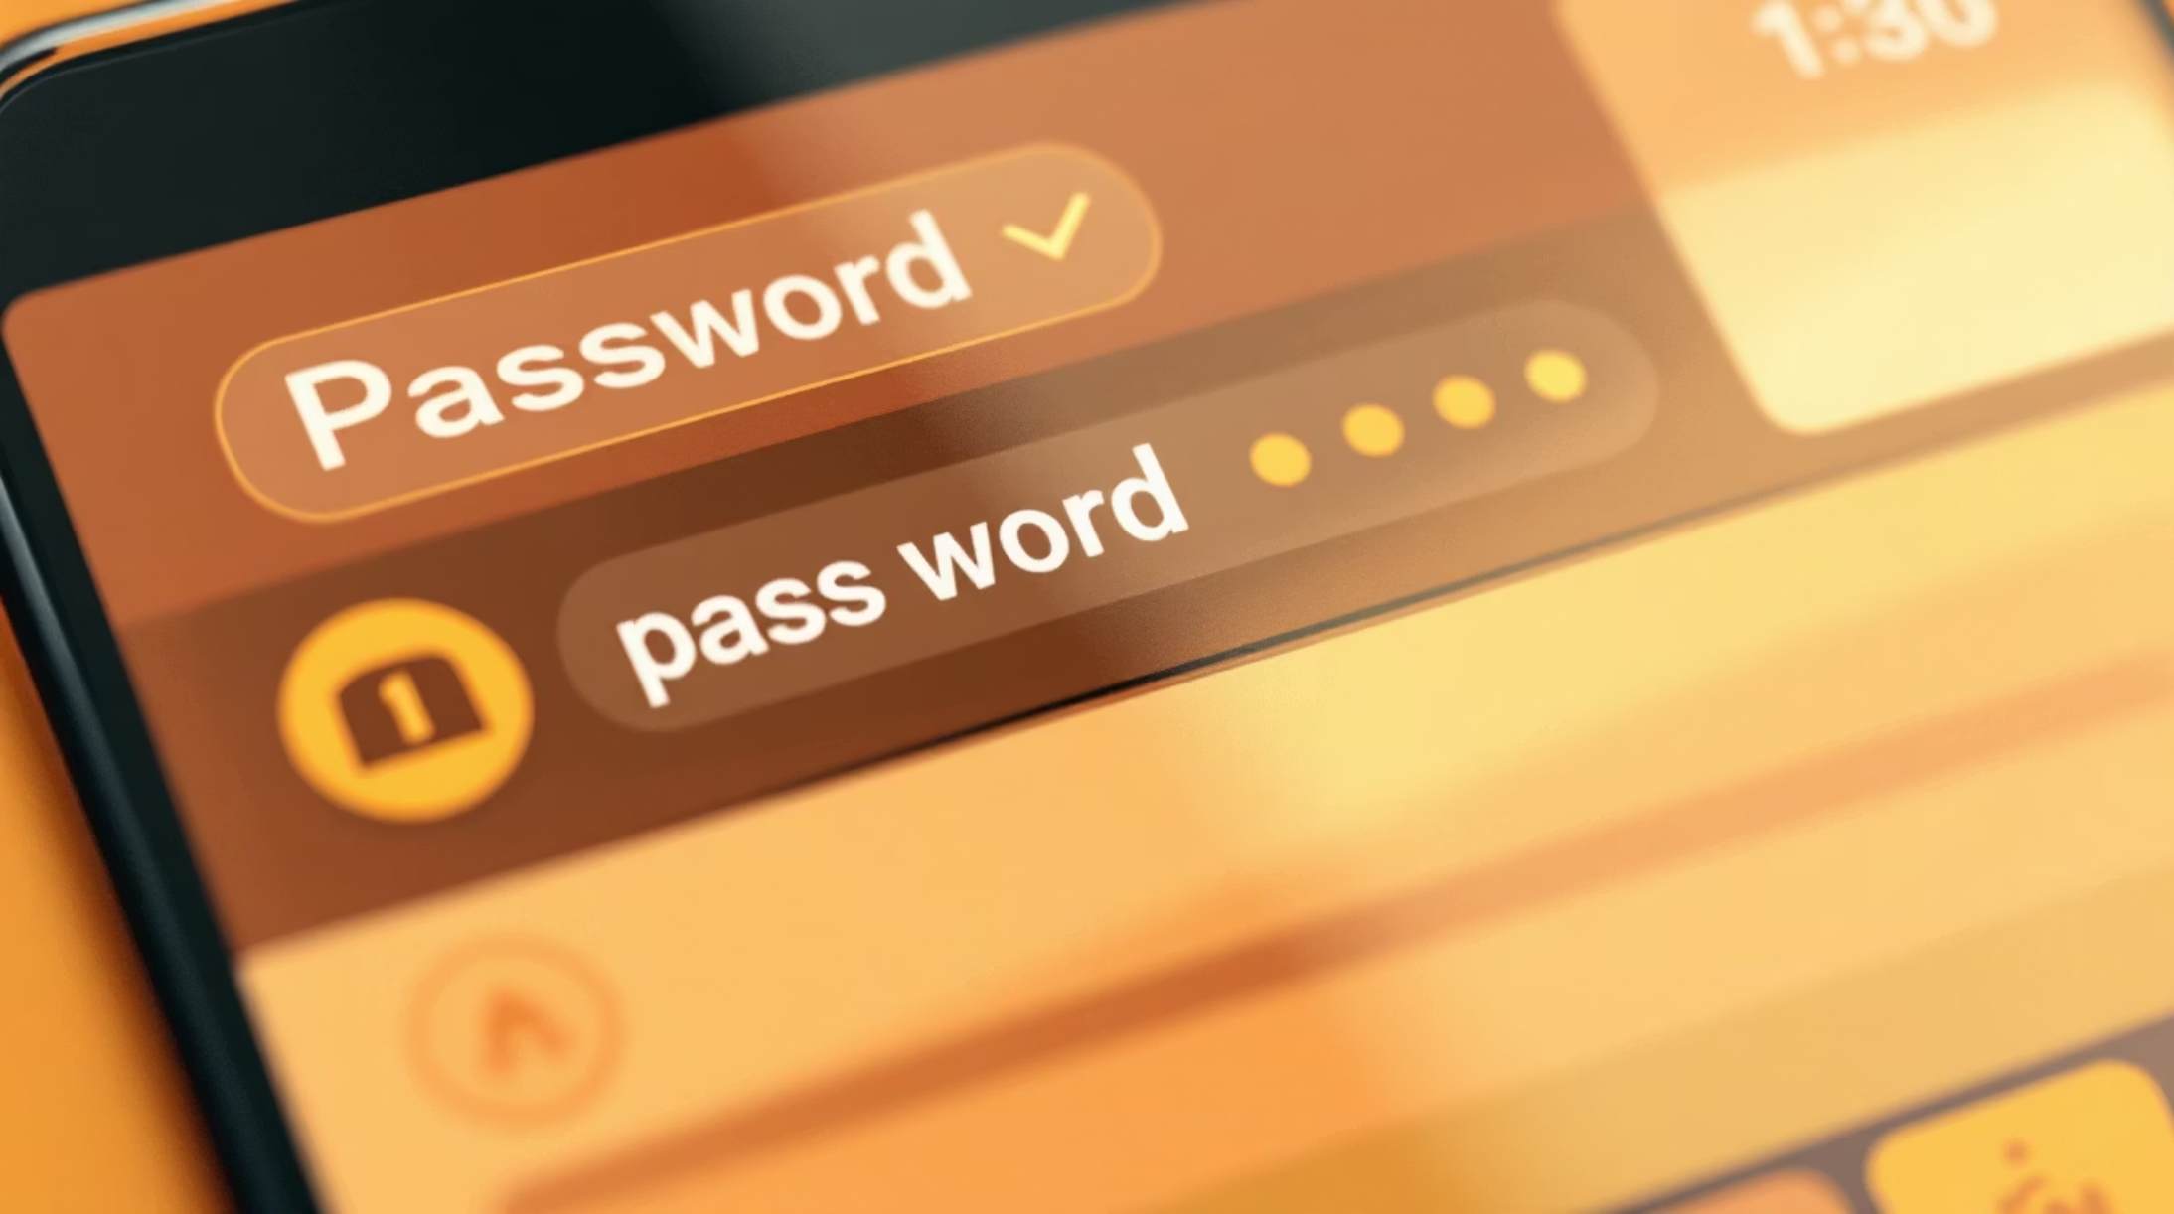
Evaluation rules (practical)
Length: base points at 8, bonus per extra character.
Character classes: lowercase, uppercase, digits, symbols — reward diversity.
Common patterns: penalize repeated chars, sequential keys, common passwords list.
Dictionary checks: detect words or names (client-side fuzzy list or hashed lookup).
Entropy estimate: combine class counts and length for a final numeric score.

Slide 6
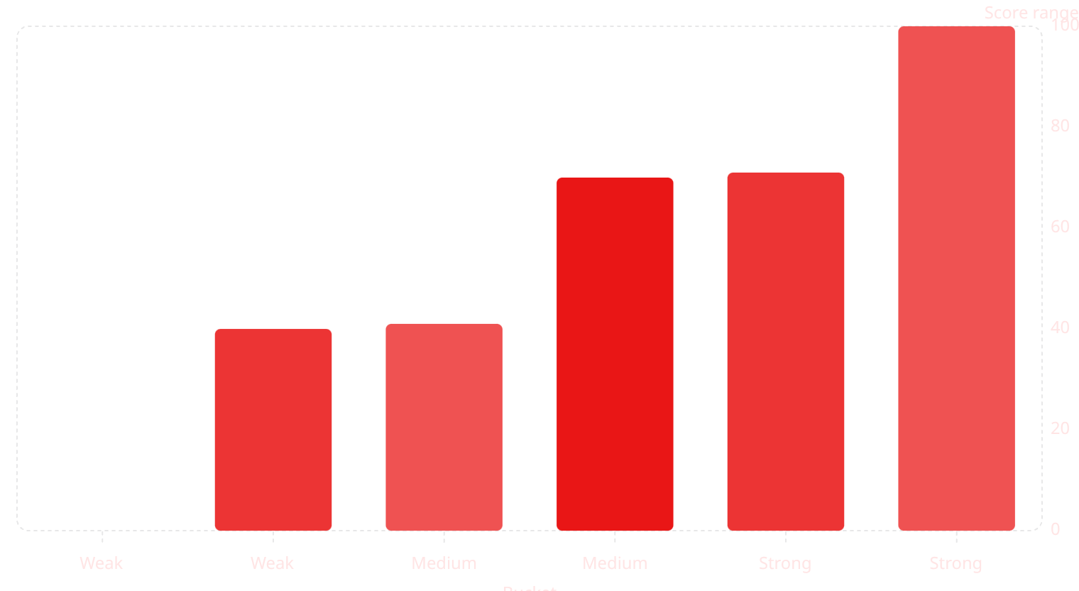
Scoring & labels
Map the numeric score to three clear labels. Use color and contrast to reinforce meaning (Weak = #ff954f accent, Medium = #cc5200, Strong = #241512 with light text).

Slide 7
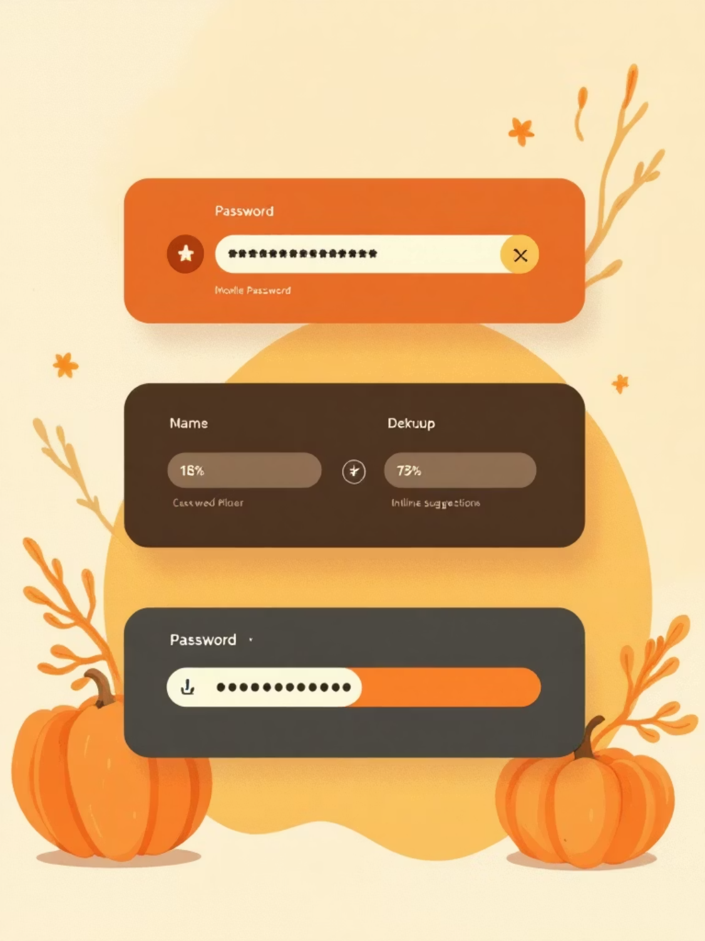
UI patterns & accessibility
Bar + percentage + textual label: multiple redundant cues for clarity.
Color + iconography: ensure color is not the sole indicator (use icons/labels).
Aria live regions: announce changes for screen readers (e.g., "Password strength: Medium").
Contrast & sizing: follow WCAG for text and interactive elements.

Slide 8
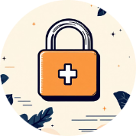



Suggestions engine
Add length
Mix case
Include numbers & symbols
Avoid common patterns
Recommend adding 4+ characters — length is the most effective improvement.
Suggest adding uppercase and lowercase letters if missing.
Encourage at least one digit and one symbol; avoid predictable substitutions.
Warn about common passwords and sequences; offer examples of safer choices.
Show zero-to-one concrete suggestions at a time; keep language action‑oriented and short.

Slide 9
Implementation checklist & code tips
Event handling
Debounce & performance
Data
Listen to input and composition events. Avoid blocking UI — keep checks synchronous and cheap.
Use compact hashed lists for common passwords and a small client-side wordlist for quick checks.
Debounce expensive checks (like fuzzy dictionary lookups) but keep visual updates responsive.
Security note
Never transmit the password to third-party services. All evaluation should remain client-side.

Slide 10
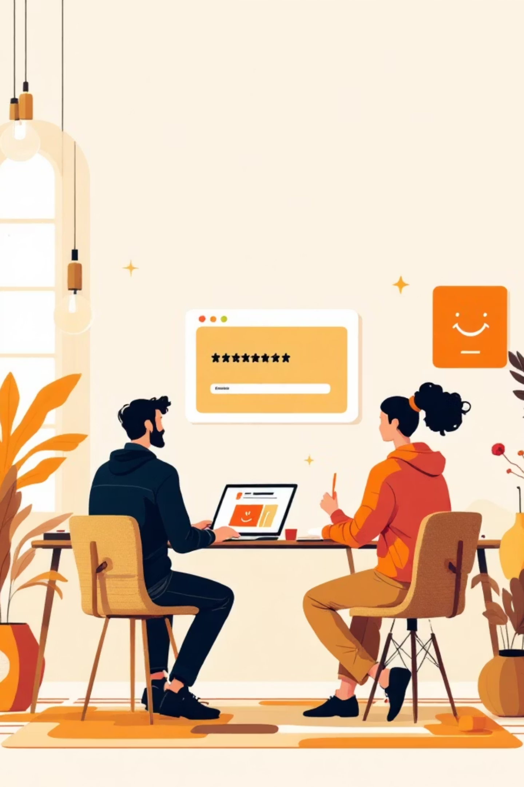
Wrap-up & next steps
Build a fast, accessible, client-side strength checker that gives clear labels, concise suggestions, and resilient UI. Next steps: prototype the meter, run accessibility audits, and user-test wording to ensure guidance is understood and actionable.

